Slide 1
Advanced Analytical Tool for Flexible Pavement Design and Evaluation
Project Sponsor: US Army, ERDC
Project PI(s): Erol Tutumluer, Maziar Moaveni
Research Assistant(s): Haohang, Jiayi, Wenjing, Sandhya
Date: Feb 12, 2018

Slide 2
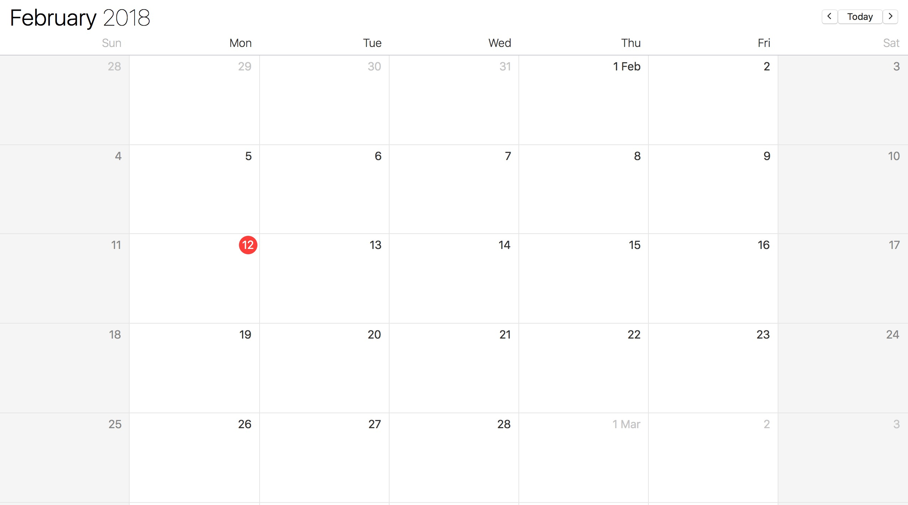
Progress since last week
1) R27-174 Unpaved Road TRP Meeting @ Springfield, time: ?
2) R27-182 Rip Rap Presentation Meeting @ Beckman, 2pm
R27-182 Rip Rap Imaging Project
Kick-off Meeting @ ATREL

Slide 3
Progress since last week
R27-182 Rip Rap Imaging Project Presentation
in progress
will be discussed on Wednesday with John, Maziar & Zixu
will be sent to Professor by Friday for review
ERDC FEM Project
collect literature on Damage models
complete programming & testing the following:
Node{.h, .cpp}
Element{.h, .cpp} ---> ElementQ4{.h, .cpp}
Shape{.h} ---> ShapeQ4{.h, .cpp}
Mesh{.h, .cpp}
Implementation with C++ features:
Inheritance and Polymorphism

Slide 4
Task 3 Damage model and transfer functions
3.1 Models for Predicting Fatigue Cracking of HMA Layers
3.1.1 Fatigue Cracking Mechanisms
3.1.2 Fatigue Cracking Modeling
3.1.3 Recommended Fatigue Model for the Design and Evaluation Tool
3.2 Models for Predicting Rutting in HMA Layers
3.2.1 Rutting Mechanisms
3.2.2 Rutting Modeling
3.2.3 Recommended Rutting Model for the Design and Evaluation Tool
3.3 Permanent Deformation Models for Granular Base and Subgrade Layers
3.3.1 Key factors of predicting permanent deformation of unbound materials
3.3.2 Permanent Deformation Modeling
3.3.3 Recommended Permanent Deformation Model for the Design and Evaluation Tool
Sandhya & Haohang collecting literature: Army’s Design method, AASHTOWare MEPDG 2015 (Thanks to Issam), proposed by individual reports & papers (better after year 2010)
Sandhya, Wenjing, Jiayi review the collected literature

Slide 5
Progress since last week
R27-182 Rip Rap Imaging Project Presentation
in progress
will be discussed on Wednesday with John, Maziar & Zixu
will be sent to Professor by Friday for review
ERDC FEM Project
collect literature on Damage models
complete programming & testing the following:
Node{.h, .cpp}
Element{.h, .cpp} ---> ElementQ4{.h, .cpp}
Shape{.h} ---> ShapeQ4{.h, .cpp}
Mesh{.h, .cpp}
Implementation with C++ features:
Inheritance and Polymorphism

Slide 6
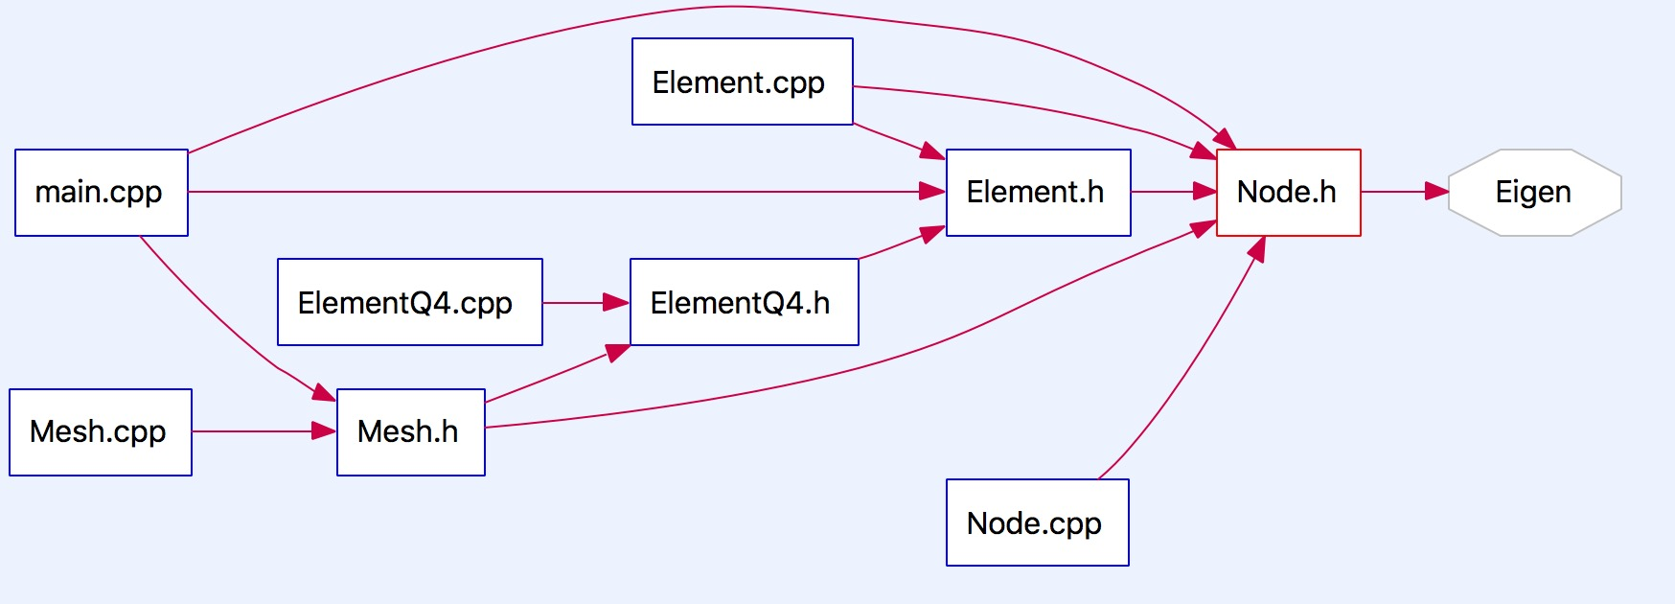
Current Implementation
Open-source, stable
Linear Algebra Solver

Slide 7
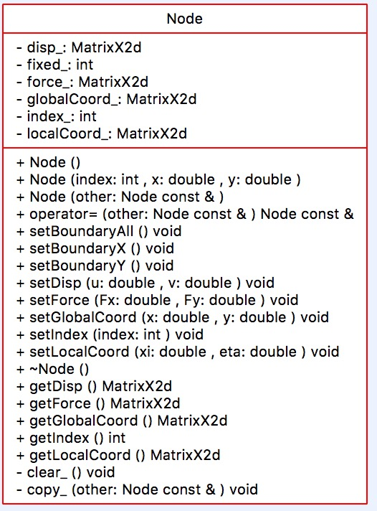
Node Class:

Slide 8
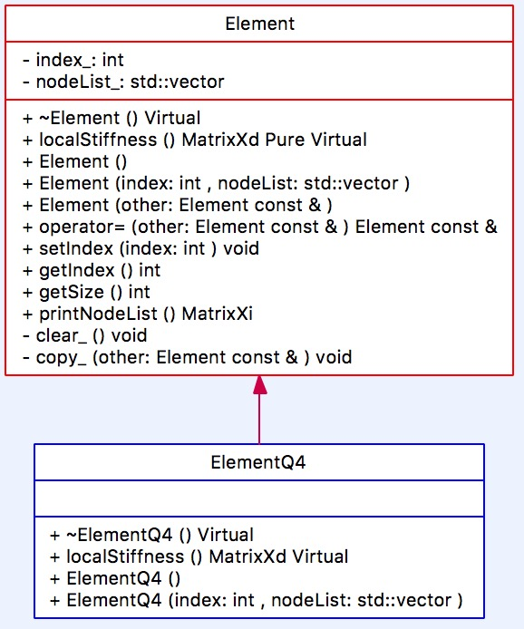
Element & ElementQ4 Class:

Slide 9
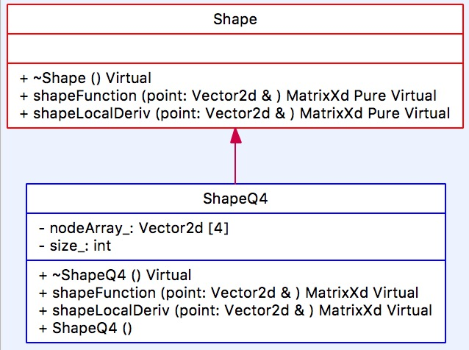
Shape & ShapeQ4 Class:

Slide 10
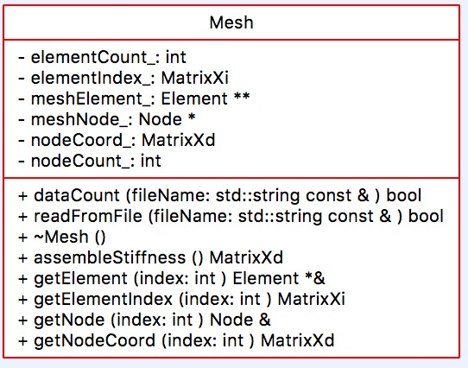
Mesh Class:

Slide 11
Future Work
R27-182 Rip Rap Imaging Project Presentation
prepare presentation
ERDC FEM Project
review on damage models
complete programming & testing the following:
Implement Element class traversal using Iterator
Test localStiffness() in Shape class
Program & Test assemblyGlobalStiffness() in Mesh class
Start writing Analysis class, and its first child class LinearElastic

